Slide 1
Fake Image Detection System
Ananya B Hegde
Bharath Kumar Reddy Kotte
Bhanu Rekha
Manoj Kandi
Sai Rejinthala
Joseph Varghese

Slide 2
Contents
Introduction
Problem Statement
Technology Used
System Architecture
Results/System Snapshots
Benefits
Conclusion & Future Work

Slide 3
introduction
Project Overview:
Project Goals:
Detect and classify deepfakes accurately.
Provide multi-language outputs and voice.
Real-time web access and data insights via Power BI.
Accessible via a Streamlit webpage with results stored in SQL and visualized using Power BI
Detects and classifies deepfake images using Azure services.
Generates image descriptions, translates them, and provides voice outputs in Hindi, Telugu, and Tamil.

Slide 4
Problem Statement
Problem:
Deepfakes pose a serious threat to digital integrity, privacy, and security. Manual detection is inefficient and lacks scalability.
Need:
An automated, scalable solution that accurately detects deepfakes, supports multi-language outputs, and provides real-time insights.
Approach:
Leverage Azure services to classify images as real or fake, generate multi-language descriptions, and offer voice outputs.
Implementation:
Integrate Azure Custom Vision and Computer Vision with a CNN-based model for deepfake detection, supported by Translator and Speech services for multilingual and voice-enabled functionality. Deploy the solution via a Streamlit webpage with data analysis through Power BI.

Slide 5
TECHNOLOGY USED
Azure Storage: Image storage.
Custom Vision: Image classification.
Computer Vision: Image descriptions.
Translator: Multi-language translation.
Speech: Text-to-speech conversion.
Azure SQL: Storing results.
Streamlit: Web interface.
Power BI: Data visualization.

Slide 6
system architecture
dffdx
Description Generation
Image Upload
Image Classification
Voice Output
Result Visualization
Data Storage
Translation

Slide 7
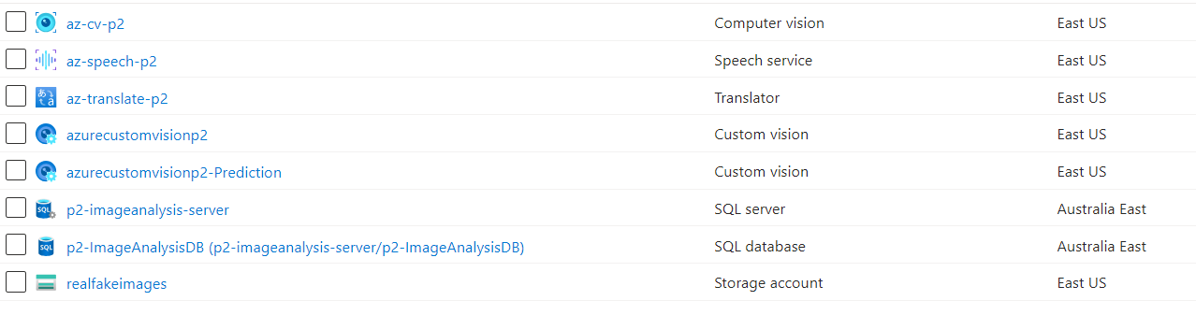
RESULTS/SYSTEM SNAPSHOTS

Slide 8
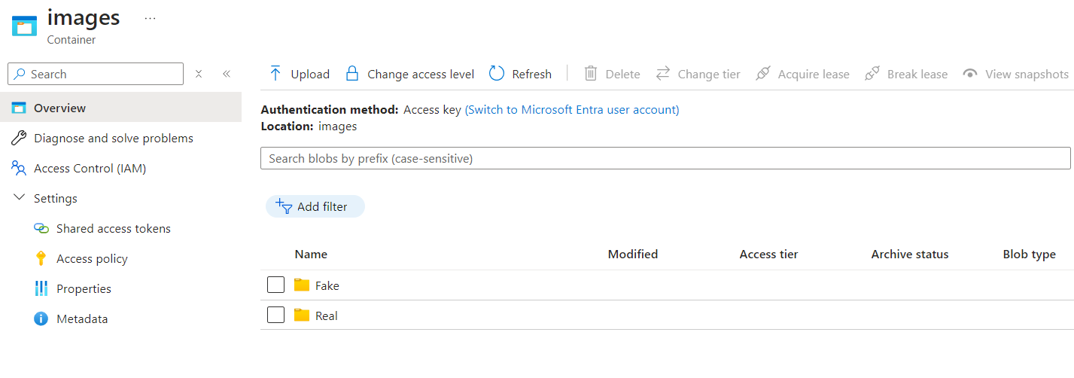
RESULTS/SYSTEM SNAPSHOTS

Slide 9
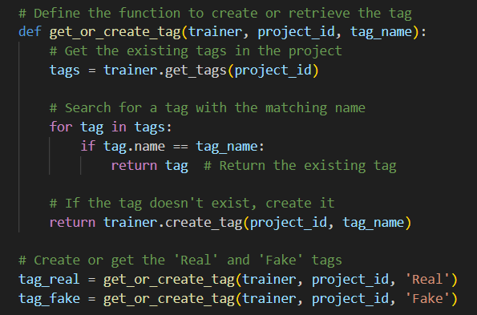
RESULTS/SYSTEM SNAPSHOTS

Slide 10
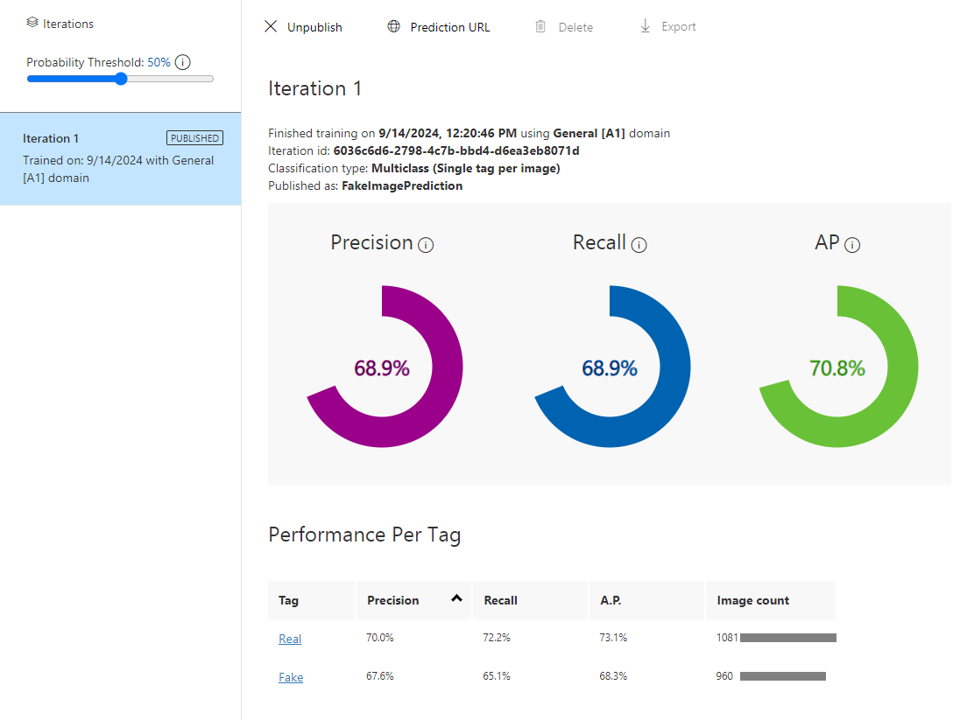
RESULTS/SYSTEM SNAPSHOTS

Slide 11
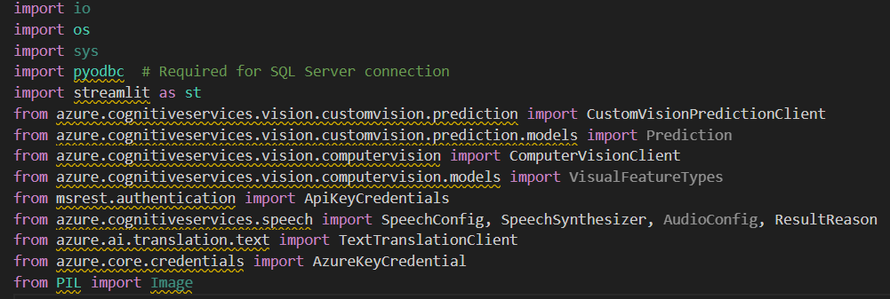
RESULTS/SYSTEM SNAPSHOTS

Slide 12
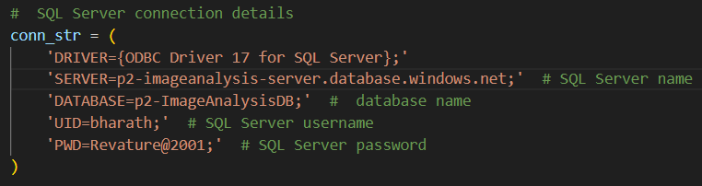
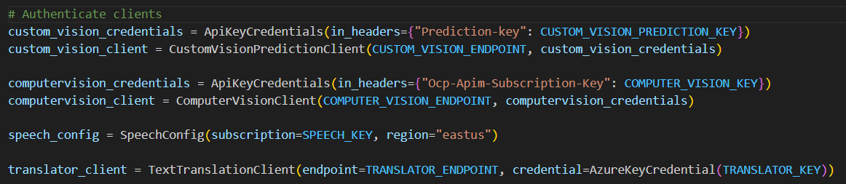
RESULTS/SYSTEM SNAPSHOTS

Slide 13

RESULTS/SYSTEM SNAPSHOTS

Slide 14
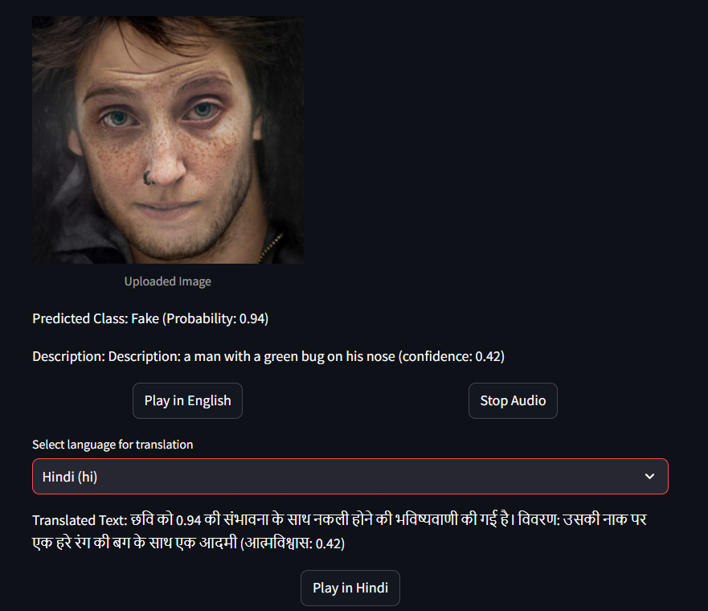
RESULTS/SYSTEM SNAPSHOTS

Slide 15
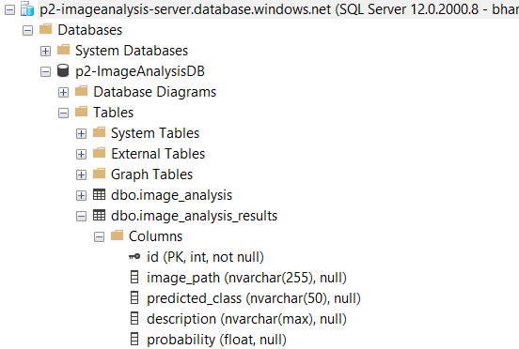
RESULTS/SYSTEM SNAPSHOTS

Slide 16
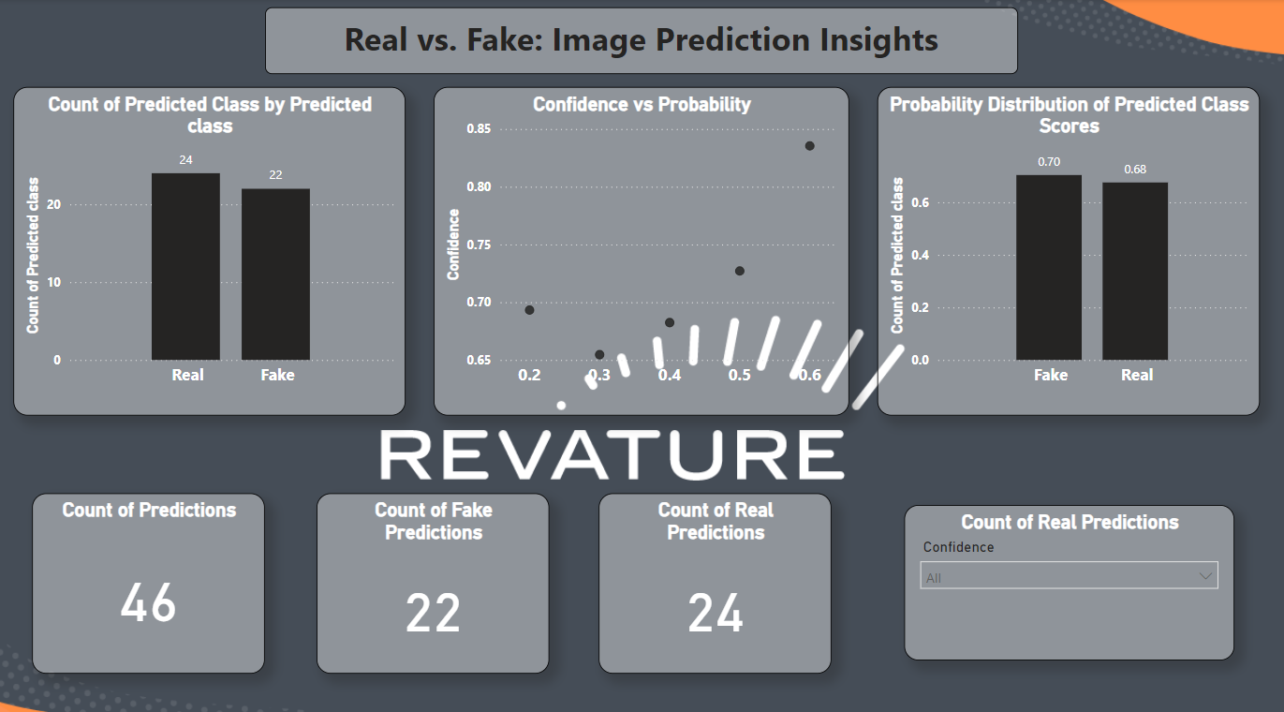
RESULTS/SYSTEM SNAPSHOTS

Slide 17
BENEFITS
Early Detection: AI detects deep fakes early, allowing quick action to prevent misinformation.
Accessibility: User-friendly apps let anyone easily check media authenticity.
Adaptability: The method adapts to different datasets and tasks, making it versatile across platforms.

Slide 18
FUTURE ENHANCEMENT
Real-Time Detection: Enables immediate alerts and continuous media verification.
IoT Integration: Smart devices add real-time data for comprehensive media authenticity analysis.
Enhanced UX: Intuitive interface with multilingual support and tutorials increases accessibility.

Slide 19
CONCLUSION
The project provides an automated solution for detecting deepfake images, enhancing digital integrity and security.
Integration of Azure services ensures scalability and robustness in classification and analysis.
Advanced machine learning models enable accurate differentiation between real and fake images.
Multi-language support enhances accessibility by offering translations and voice outputs in Hindi, Telugu, and Tamil.
The Streamlit web interface allows for user-friendly interaction and real-time results.
Data is effectively stored in Azure SQL Database, facilitating easy retrieval and analysis.
Insights are visualized through Power BI dashboards, providing valuable trends and analytics for users.

Slide 20
Thank you…

